Slide 2
CONTENTS: 1.WEATHER AND CLIMATE 2.FACTORS INFLUENCING CLIMATE 3.HEAT ZONES
5.WEATHER AND CLIMATE

Slide 3
Weather is the condition of the atmosphere at a particular place over a short period of time. Climate is the long-term average of weather, typically averaged over a period of 30 years.
WEATHER AND CLIMATE
Chapter 5/Social Dept/Karunambigai/Sns Academy

Slide 4
FACTORS INFLUENCING THE CLIMATE
1.DISTANCE FROM THE EQUATOR.
2.HEIGHT ABOVE THE SEA LEVEL.(ALTITUDE)
3.DISTANCE FROM THE SEA.
4.DIRECTIONS OF WINDS.
5.HUMUDITY AND RAINFALL.
CHAPTER 5/KARUNAMBIGAI/SOCIAL DEPT/SNS ACADEMY

Slide 5
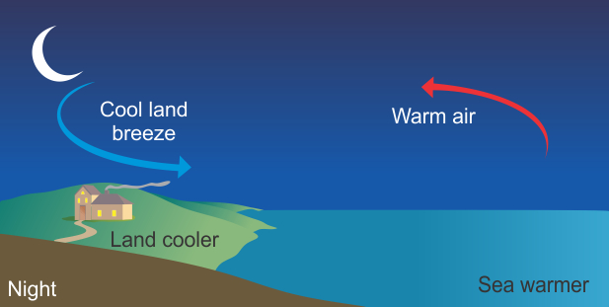
Land breeze
Land breeze blows during the night from land to sea and the land becomes cooler faster than the sea. The air above the sea becomes less dense (i.e. warmer) and rises. The cooler air from the land moves in to take its place.
Chapter 4/social/karunambigai/Sns Academy

Slide 6
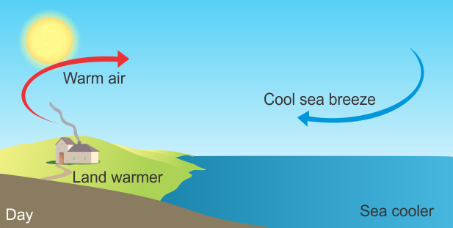
Sea breeze: Sea breeze blows during the day and the land heats up faster than the sea. The air on land becomes less dense (i.e.warmer) and rises so the cooler air over the sea which is denser(cooler) flows in to take the place of the warm air, causing a sea breeze.
SEA BREEZE
Sea breeze:
Sea breeze blows during the day and the land heats up faster than the sea. The air on land becomes less dense (i.e.warmer) and rises so the cooler air over the sea which is denser(cooler) flows in to take the place of the warm air, causing a sea breeze.

Slide 7
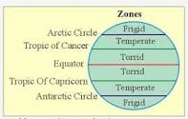
1.TORRID ZONE 2.TEMPERATE ZONE 3.FRIGID ZONE
HEAT ZONES

Slide 8
TORRID ZONE
The torrid zone refers to the area of the earth between the Tropic of Cancer and the Tropic of Capricorn. Geographically, the torrid zone is defined by 23.5 degrees north latitude and 23.5 degrees south latitude.
Torrid Zone is the hottest because it is very close to the equator. At this zone, the sun is very close to the earth and it receives the maximum heat from the sun.

Slide 9
In geography, the temperate or tepid climates of Earth occur in the middle latitudes, which span between the tropics and the polar regions of Earth. In most climate classifications, temperate climates refer to the climate zone between 35 and 50 north and south latitudes
TEMPERATE ZONE
Average yearly temperatures in these regions are not extreme, not burning hot nor freezing cold. Temperate means moderate.

Slide 10
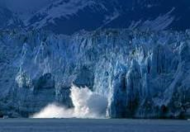
CHAPTER 5/KARUNAMBIGAI/SOCIAL DEPT/SNS ACADEMY
FRIGID ZONE
Frigid Zone is the area between the Arctic Circle and the North Pole or between the Antarctic Circle and the South Pole. This climate is characterized by a long season of severe winter and even the summer season is cold. The precipitation is very low, generally below 30 cm.

